Slide 1
Matrix & Vector
Chiang_Ch4.ppt

Slide 2
Matrix Algebra
4.1 Matrices and Vectors
4.2 Matrix Operations
4.3 Notes on Vector Operations
4.4 Commutative, Associative, and Distributive Laws
4.5 Identity Matrices and Null Matrices
4.6 Transposes and Inverses
4.7 Finite Markov Chains
Chiang_Ch4.ppt

Slide 3
Objectives of math for economists
To understand mathematical economics problems by stating the unknown, the data and the conditions
To plan solutions to these problems by finding a connection between the data and the unknown
To carry out your plans for solving mathematical economics problems
To examine the solutions to mathematical economics problems for general insights into current and future problems
Chiang_Ch4.ppt

Slide 4
3.4 Solution of a General-equation System
Given (p. 44)
2x + y = 12
4x + 2y = 24
Find x*, y*
y = 12 – 2x
4x + 2(12 – 2x) = 24
4x +24 – 4x = 24
0 = 0 ? indeterminant!
Why?
4x + 2y =24
2(2x + y) = 2(12)
one equation with two unknowns
2x + y = 12
x, y
Conclusion:
not all simultaneous equation models have solutions
Chiang_Ch4.ppt

Slide 5
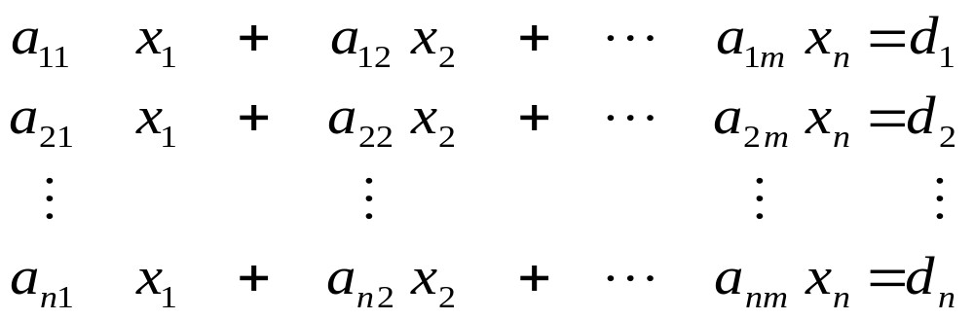
4.1 Matrices and Vectors
Matrices as Arrays
Vectors as Special Matrices
Assume an economic model as system of linear equations in which
a_{ij} parameters, where
i = 1.. n rows, j = 1.. m columns, and n=m
x_{i} endogenous variables,
d_{i} exogenous variables and constants
Chiang_Ch4.ppt

Slide 6
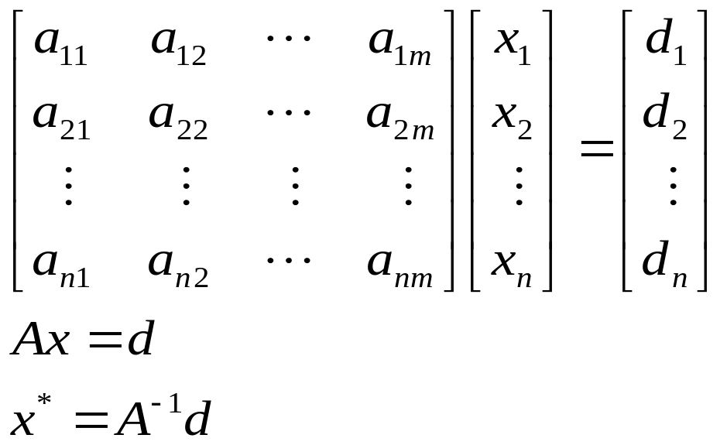
4.1 Matrices and Vectors
A is a matrix or a rectangular array of elements in which the elements are parameters of the model in this case.
A general form matrix of a system of linear equations
Ax = d where
A = matrix of parameters (upper case letters => matrices)
x = column vector of endogenous variables, (lower case => vectors)
d = column vector of exogenous variables and constants
Solve for x*
Chiang_Ch4.ppt

Slide 7
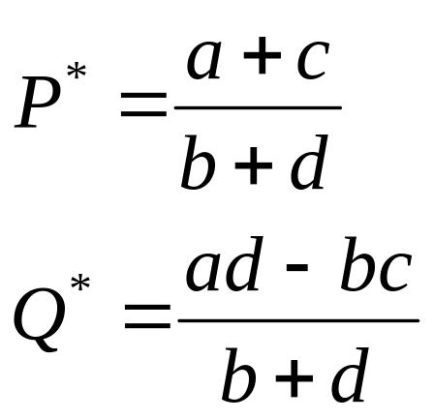
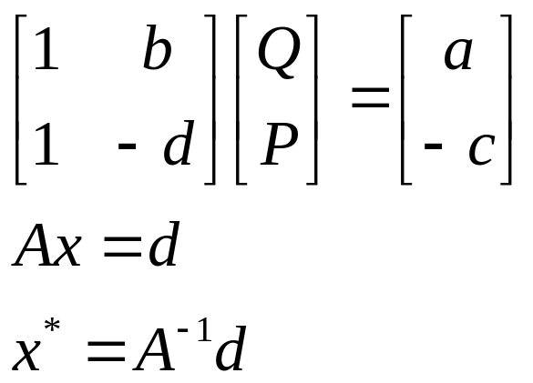
One Commodity Market Model
(2x2 matrix)
Economic Model (p. 32)
1) Q_{d}=Q_{s}
2) Q_{d} = a – bP (a,b >0)
3) Q_{s} = -c + dP (c,d >0)
Find P* and Q*
Scalar Algebra
Endog. :: Constants
4) 1Q + bP = a
5) 1Q – dP = -c
Matrix Algebra
Chiang_Ch4.ppt

Slide 8
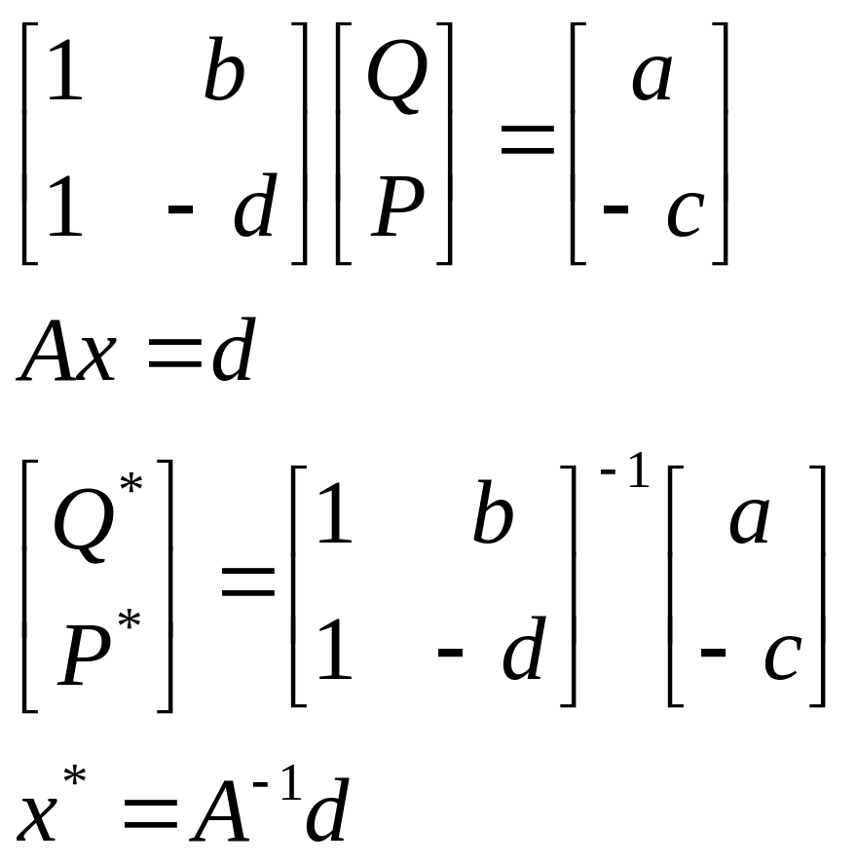
One Commodity Market Model
(2x2 matrix)
Matrix algebra
Chiang_Ch4.ppt

Slide 9
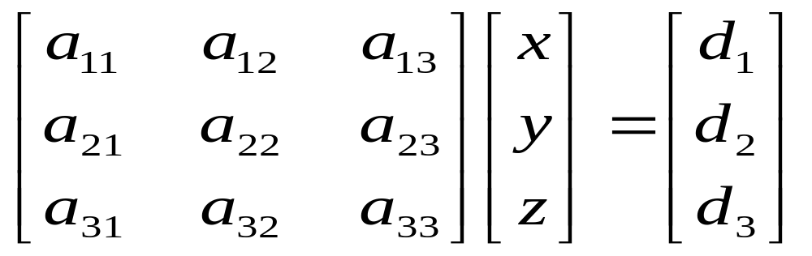
General form of 3x3 linear matrix
_{Scalar algebra form}
parameters & endogenous variables |  |  | _{exog. vars &} _{const.}
a₁₁x | + a₁₂y | + a₁₃z | = d₁
a₂₁x | + a₂₂y | + a₂₃z | = d₂
a₃₁x | + a₃₂y | + a₃₃z | = d₃
Matrix algebra form
parameters | endog. vars | exog. vars. & constants
Chiang_Ch4.ppt

Slide 10
1. Three Equation National Income Model (3x3 matrix)
Let
Y = C + I₀ + G₀
C = a + b(Y-T) (a > 0, 0<b<1)
T = d + tY (d > 0, 0<t<1)
Endogenous variables?
Exogenous variables?
Constants?
Parameters?
Why restrictions on the parameters?
Chiang_Ch4.ppt

Slide 11
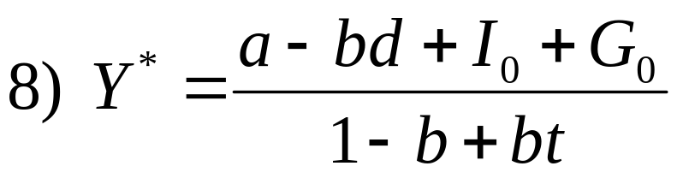
2. Three Equation National Income Model
Endogenous: Y, C, T: Income (GNP), Consumption, and Taxes
Exogenous: I₀ and G₀: autonomous Investment & Government spending
Constants a & d: autonomous consumption and taxes
Parameter t is the marginal propensity to tax gross income 0 < t < 1
Parameter b is the marginal propensity to consume private goods and services from gross income 0 < b < 1
Chiang_Ch4.ppt

Slide 12
3. Three Equation National Income Model (substitution method)
Let the national income model be
1) Y = C + I₀ + G₀
2) C = a + b(Y - T) (a > 0, 0 < b < 1)
3) T = d + tY (d > 0, 0 < t < 1)
Solve for Y*
4) Y= a +bY - bT + I₀+ G₀ 2) -> 1)
5) Y= a +bY – b(d + tY) + I₀+ G₀ 3) -> 4)
6) Y= a +bY – bd -btY + I₀+ G₀ expand
7) Y – bY +btY= a – bd + I₀+ G₀ collect terms & factor
Chiang_Ch4.ppt

Slide 13
4. Three Equation National Income Model
Economic Model
Y = C + I₀ + G₀
C = a + b(Y-T)
T = d + tY
Find Y*, C*, T*
Parameters & Endogenous vars. |  |  |  | Exog. vars.
Y | C | T |  | &cons.
1Y | -1C | +0T | = | I₀+G₀
-bY | +1C | +bT | = | a
-tY | +0C | +1T | = | d
Chiang_Ch4.ppt

Slide 14
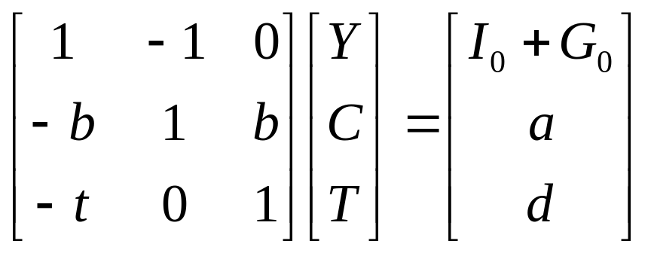
5. Three Equation National Income Model
Parameters & Endogenous vars. |  |  |  | Exog. vars.
Y | C | T |  | &cons.
1Y | -1C | +0T | = | I₀+G₀
-bY | +1C | +bT | = | a
-tY | +0C | +1T | = | d
Chiang_Ch4.ppt

Slide 15
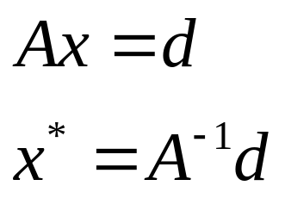
6. Three Equation National Income Model
Parameters & Endogenous vars. |  |  |  | Exog. vars.
Y | C | T |  | &cons.
1Y | -1C | +0T | = | I₀+G₀
-bY | +1C | +bT | = | a
-tY | +0C | +1T | = | d
Given
Y = C + I₀ + G₀
C = a + b(Y-T)
T = d + tY
Find Y*, C*, T*
Chiang_Ch4.ppt

Slide 16
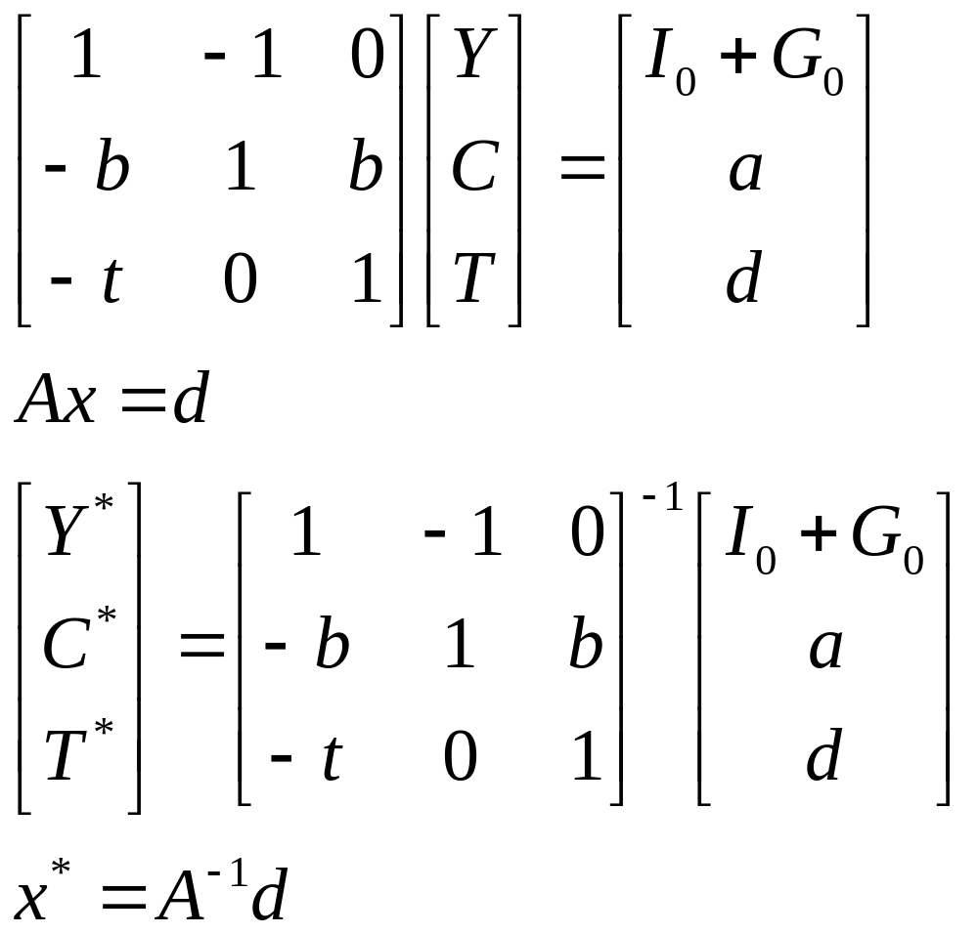
7. Three Equation National Income Model
Chiang_Ch4.ppt

Slide 17
1. Two Commodity Market Equilibrium
Economic Model
1) Q_{di} = Q_{si,} i=1, 2
2) Q_{d1} = 10 - 2P₁ + P₂
3) Q_{s1} = -2 +3P₁
4) Q_{d2} = 15 + P₁ - P₂
5) Q_{s2} = -1 + 2P₂
Find Q₁*, Q₂*, P₁*, P₂*
Chiang_Ch4.ppt

Slide 18
2. Two Commodity Market Equilibrium
Scalar algebra form
(endog on left & exog/const on right)
1Q₁ +0Q₂ +2P₁ - 1P₂ = 10
1Q₁ +0Q₂ - 3P₁ +0P₂= -2
0Q₁ +1Q₂ - 1P₁ +1P₂= 15
0Q₁ +1Q₂ +0P₁ - 2P₂= -1
Chiang_Ch4.ppt

Slide 19
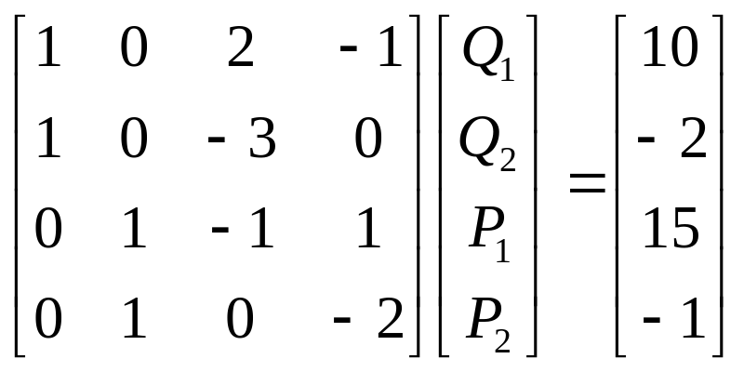
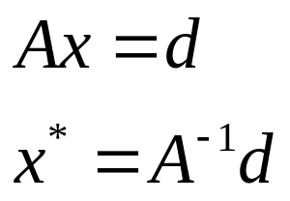
3. Two Commodity Market Equilibrium
Section 3.4, p. 42
Given
Q_{di} = Q_{si,} i=1, 2
Q_{d1} = 10 - 2P₁ + P₂
Q_{s1} = -2 + 3P₁
Q_{d2} = 15 + P₁ - P₂
Q_{s2} = -1 + 2P₂
Find Q₁*, Q₂*, P₁*, P₂*
Scalar algebra
1Q₁ +0Q₂ +2P₁ - 1P₂ = 10
1Q₁ +0Q₂ - 3P₁ +0P₂= -2
0Q₁+ 1Q₂ - 1P₁ + 1P₂= 15
0Q₁+ 1Q₂ +0P₁ - 2P₂= -1
Chiang_Ch4.ppt

Slide 20
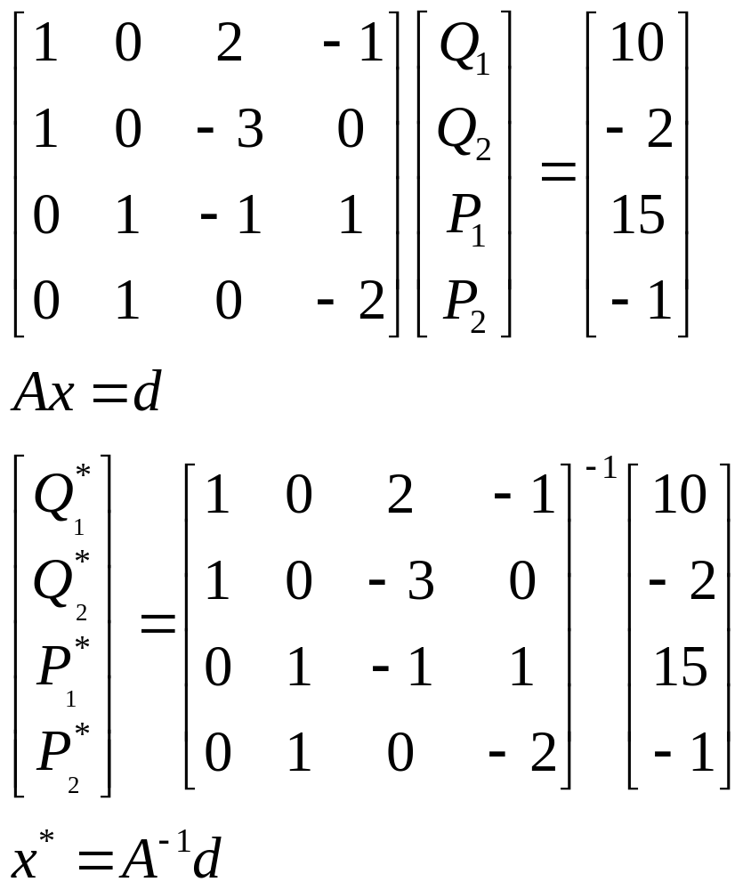
4. Two Commodity Market Equilibrium
Chiang_Ch4.ppt

Slide 21
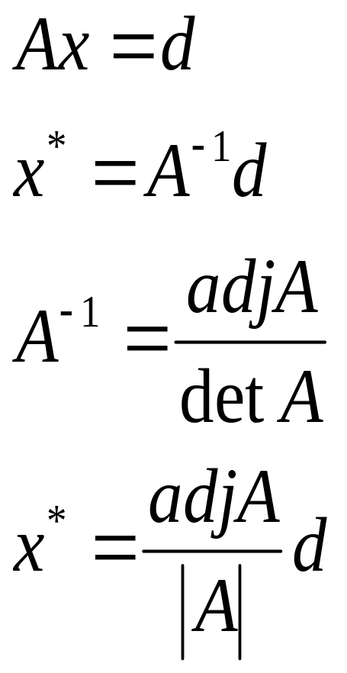
Ch. 4 Linear Models & Matrix Algebra
Matrix algebra can be used:
a. to express the system of equations in a compact notation;
b. to find out whether solution to a system of equations exist; and
c. to obtain the solution if it exists. Need to invert the A matrix to find the solution for x*
Chiang_Ch4.ppt

Slide 22
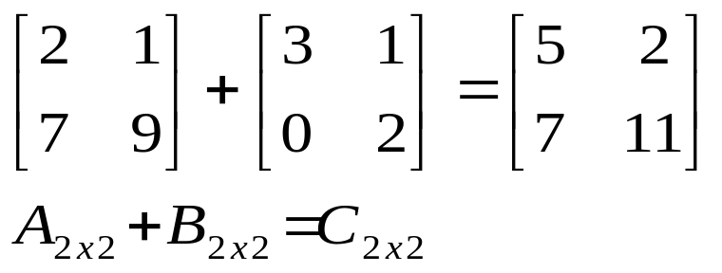
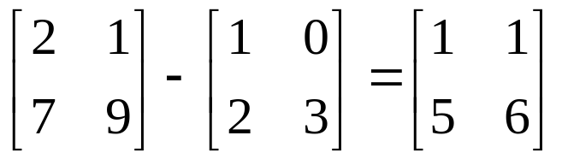
Addition and Subtraction of Matrices
Scalar Multiplication
Multiplication of Matrices
The Question of Division
Digression on Σ Notation
4.2 Matrix Operations
Matrix addition
Matrix subtraction
Chiang_Ch4.ppt

Slide 23
4.3 Geometric interpretation
x₂
v = [2 3]
u = [3 2]
v+u = [5 5]
5
4
3
2
1
x₁
1 2 3 4 5
Chiang_Ch4.ppt

Slide 24
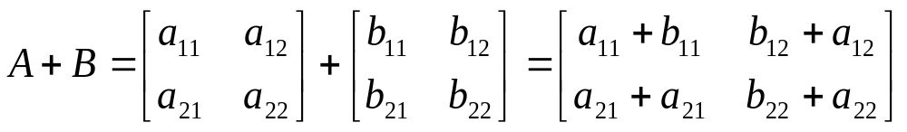
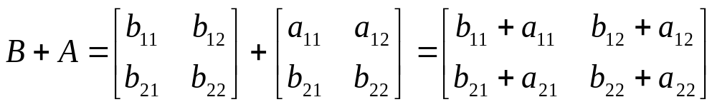
4.4 Laws of Matrix Addition & Multiplication
Matrix Addition
Matrix Multiplication
Commutative law: A + B = B + A
Chiang_Ch4.ppt

Slide 25
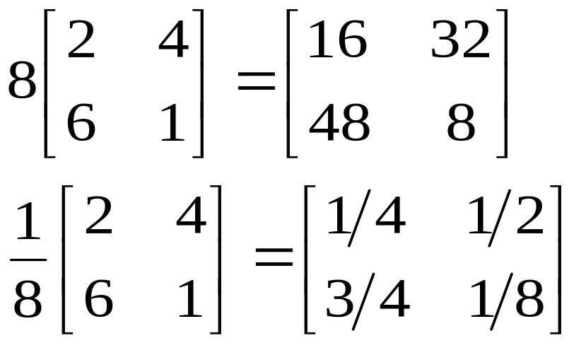
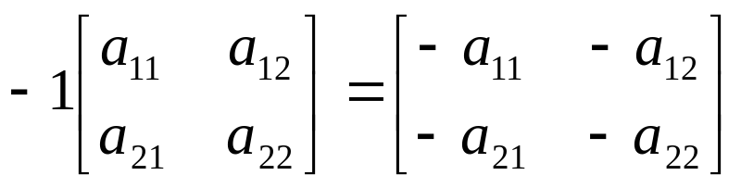
4.2 Scalar multiplication
Chiang_Ch4.ppt

Slide 26



4.3 Geometric interpretation (2)
x₂
Scalar multiplication
Source of linear dependence
6
5
4
3
2
1
x₁
-4 -3 -2 -1 1 2 3 4 5 6
-2
Chiang_Ch4.ppt

Slide 27
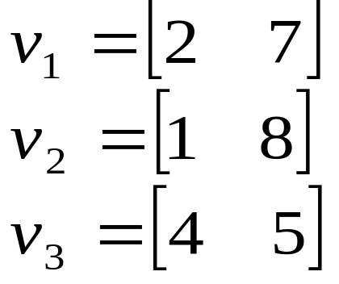
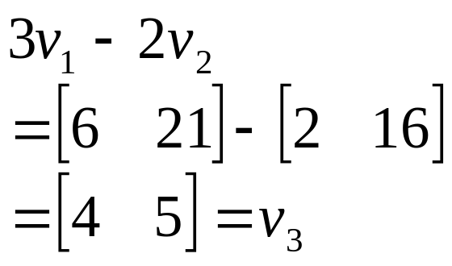
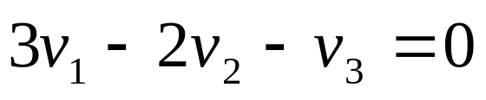
4.3 Linear dependence
A set of vectors is linearly dependent if any one of them can be expressed as a linear combination of the remaining vectors; otherwise it is linearly independent.
Dependence prevents solving the system of equations. More unknowns than independent equations.
Chiang_Ch4.ppt

Slide 28
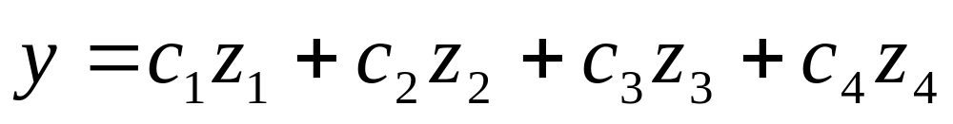
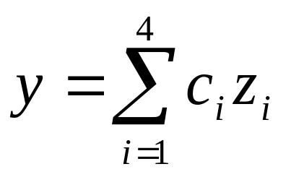
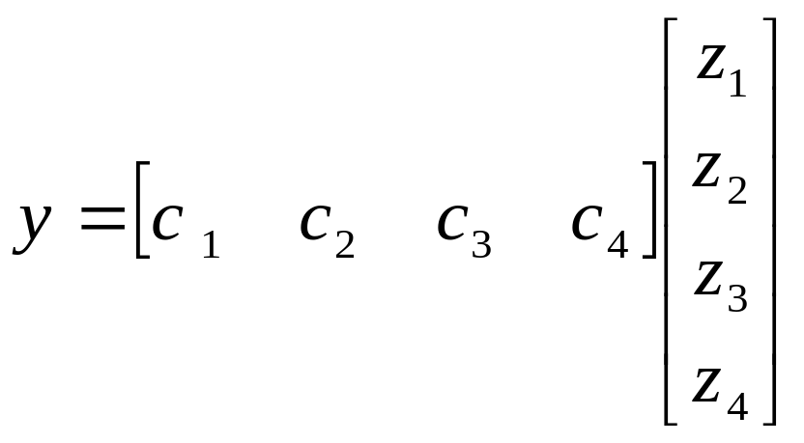
4.1Vector multiplication
(inner or dot product)
    y = c.z
    1x1 = (1x4)( 4x1)
Chiang_Ch4.ppt

Slide 29
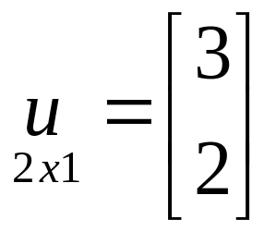
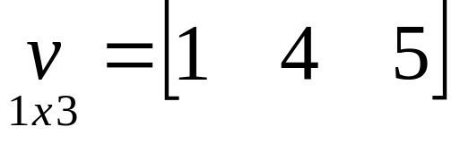
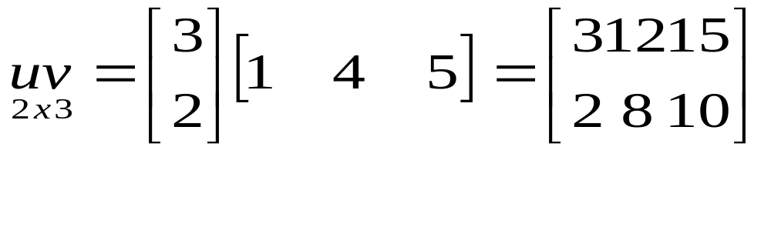
4.3 Notes on Vector Operations
Multiplication of Vectors
Geometric Interpretation of Vector Operations
Linear Dependence
Vector Space
An [m x 1] column vector u and a [1 x n] row vector v, yield a product matrix uv of dimension [m x n].
Chiang_Ch4.ppt

Slide 30
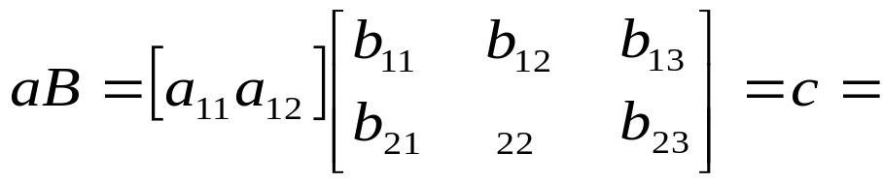
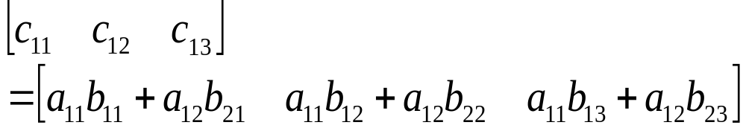
4.2 Matrix multiplication
Multiplication of matrices require conformability condition
The conformability condition for multiplication is that the column dimensions of the lead matrix A must be equal to the row dimension of the lag matrix B.
What are the dimensions of the vector, matrix, and result?
Dimensions: a(1x2), B(2x3), c(1x3)
Chiang_Ch4.ppt

Slide 31
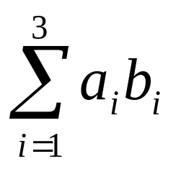
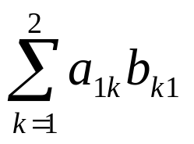
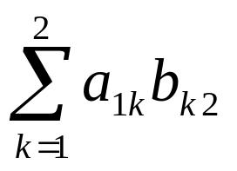

4.2 Σ notation
Greek letter sigma (for sum) is another convenient way of handling several terms or variables
i is the index of the summation
What is the notation for the dot product?
a₁b₁ +a₂b₂ +a₃b₃ =
Chiang_Ch4.ppt

Slide 32
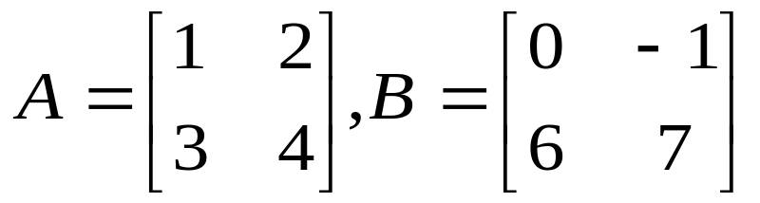
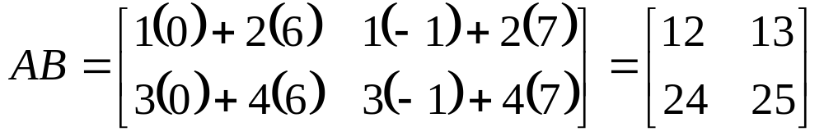
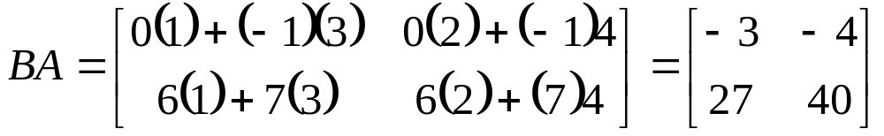
4.4 Matrix Multiplication
Matrix multiplication is generally not commutative. That is, AB ≠ BA even if BA is conformable
(because diff. dot product of rows or col. of A&B)
Chiang_Ch4.ppt

Slide 33
4.4 Matrix multiplication
Exceptions
AB=BA iff
  B = a scalar,
  B = identity matrix I, or
  B = the inverse of A, i.e., A⁻¹
Chiang_Ch4.ppt

Slide 34
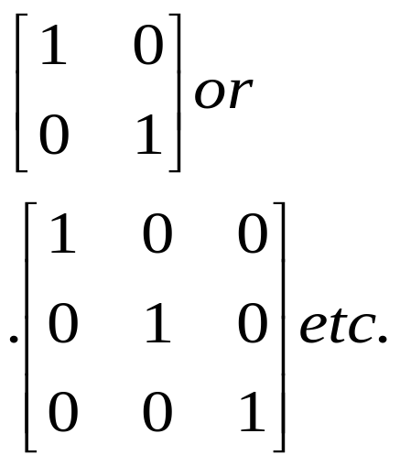
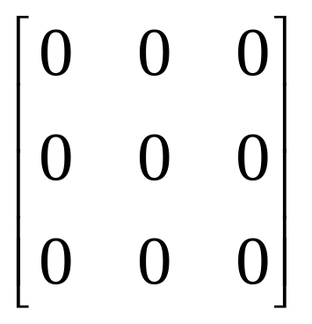
4.5 Identity and Null Matrices
Identity Matrices
Null Matrices
Idiosyncrasies of Matrix Algebra
Identity Matrix is a square matrix and also it is a diagonal matrix with 1 along the diagonals
similar to scalar “1”
Null matrix is one in which all elements are zero
similar to scalar “0”
Both are “idempotent” matrices
A = A^{T} and
A = A² = A³ = …
Chiang_Ch4.ppt

Slide 35
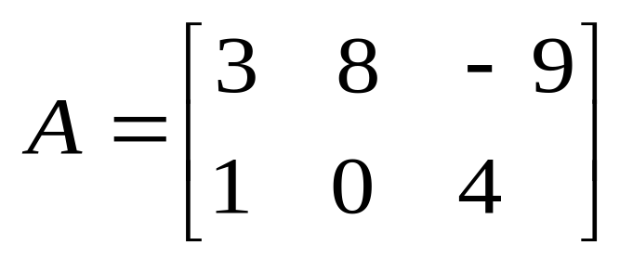
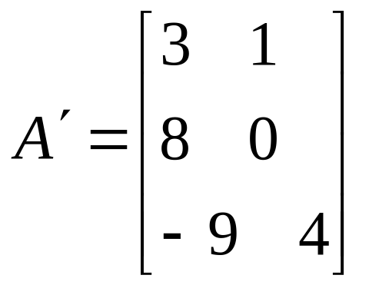
4.6 Transposes & Inverses
Properties of Transposes
Inverses and Their Properties
Inverse Matrix and Solution of Linear-equation Systems
Transposed matrices
(A')' = A
Matrix rotated along its principle major axis (running nw to se)
Conformability changes unless it is square
Chiang_Ch4.ppt

Slide 36
4.6 Inverse matrix
AA⁻¹ = I
A⁻¹A=I
Necessary for matrix to be square to have inverse
If an inverse exists it is unique
D=(A⁻¹)'
A x = d
A⁻¹A x = A⁻¹ d
Ix = A⁻¹ d
x = A⁻¹ d
Solution depends on A⁻¹
Linear independence
Determinant test!
Chiang_Ch4.ppt

Slide 37
4.2 Matrix inversion
It is not possible to divide one matrix by another. That is, we can not write A/B. This is because for two matrices A and B, the quotient can be written as AB⁻¹ or B⁻¹A.
In matrix algebra
AB⁻¹ ≠ B⁻¹ A. Thus writing does not clearly identify whether it represents
AB⁻¹ or B⁻¹A
Matrix division is matrix inversion
(topic of ch. 5)
Chiang_Ch4.ppt

